Slide 1

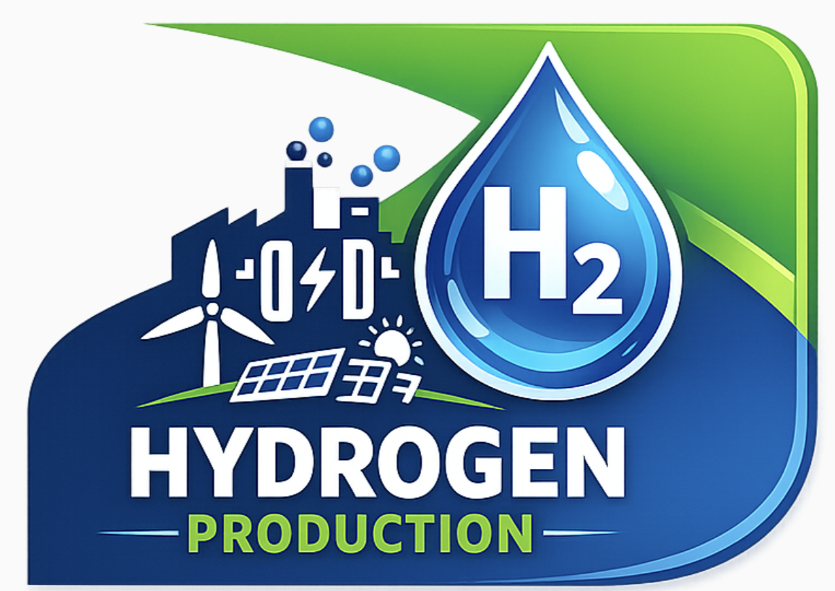

Course: Research Dissertation (ENGM083)
Next Generation Green Hydrogen from UK Offshore Wind
Prepared by:
Syed Yousaf Munib (6933767)
Supervisor: Dr. Bahman Amini Horri
Syed Yousaf Munib | 6933767 | sm04531@surrey.ac.uk
1

Slide 2
Course: Research Dissertation (ENGM083)
Aim and Problem Statement
RESEARCH AIM
PROBLEM STATEMENT
1
1
Evaluate PEM water electrolysis for green hydrogen production using UK offshore wind energy.
Design gap: No integrated offshore hydrogen system discuss.
2
2
Compare PEM performance with alkaline and solid oxide electrolyser technologies.
Technology Gap: No Justified electrolyser selection for offshore.
3
3
Design a complete offshore system, seawater treatment, hydrogen production, compression, storage (350 bar) and transportation.
Simulation gap: Variable wind impact on hydrogen output unknown.
4
4
Economic gap: CAPEX, OPEX & Payback not assessed with storge and transportation.
Assess techno economic feasibility CAPEX, OPEX, and payback period.
Syed Yousaf Munib | 6933767 | sm04531@surrey.ac.uk
2

Slide 3
Course: Research Dissertation (ENGM083)
Objectives & Key Insights
Objectives and Key Insights
Objective 01
Objective 02
Objective 03
Objective 04
Design system:
Seawater treatment, PEM electrolysis, hydrogen compression, Storage and transportation.
Compare and select:
Review alkaline, PEM, solid oxide electrolyser and justify the selection of PEM.
Simulate:
Aspen HYSYS simulation model and perform mass and energy balance calculations.
Techno economic analysis:
CAPEX, OPEX, and payback period including the effect of hydrogen storage and transportation.
KEY INSIGHT : PEM Suitability for Offshore Hydrogen
50-80 °C
Fast
>99.9%
350 bar
Operating Temp.
Response Time
H₂ Purity
Storage Target
Low temperature and suitable for offshore platforms.
Rapid response to variable wind power input.
High purity output meets storage requirements.
Commercially viable compressed H₂ storage.
Sources: (Aminaho et al.,2025; Ibrahim et al., 2022 )
3

Slide 4
Course: Research Dissertation (ENGM083)
Literature Review
Comparison of electrolyser Technologies: Three main electrolyser technologies are identified in the literature. PEM is selected for this study due to its suitability for variable offshore wind power.
Parameter
Alkaline (AWE)
PEM ✓
Solid Oxide (SOEC)
Maturity
High (commercial)
High (commercial)
Low-medium
Operating Temp.
60-90 °C
50-80 °C
700-1000 °C
Efficiency
60-75%
65-80%
70-90%
Dynamic Response
Slow
Fast
Poor
Table 1: Comparison of electrolyser technologies.
H₂ Purity
Moderate
Very High
High
Water Quality
Moderate
High purity
High purity
Capital Cost
Low
Medium
High
Offshore Suitability
Moderate
High
Low
Sources: (Aminaho et al.,2025; Carmo et al., 2013; Niblett et al., 2024)
4

Slide 5
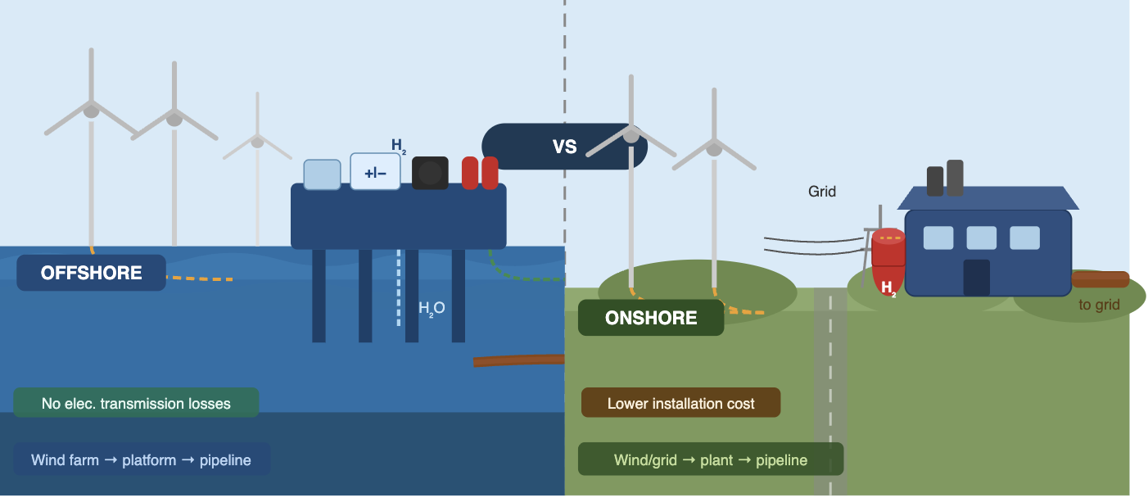
Course: Research Dissertation (ENGM083)
Comparison of offshore and onshore
Parameter | Offshore Production | Onshore Production
Location | Near offshore wind farms | On land, grid-connected
Elec. Transmission | Not required | Required (2–5% losses)
Energy Efficiency | Higher (fewer cable losses) | Lower
Maintenance Access | Difficult | Easier
Installation Cost | Higher | Lower
Scalability for UK | High | Limited by grid capacity
System Complexity | High | Moderate
UK Suitability | High | Moderate
Figure 1: Comparing offshore and onshore hydrogen production.
Table 2: Key parameter comparison of offshore vs onshore hydrogen production.
Sources: (Ibrahim et al., 2022; Rezaei et al., 2024; Travaglini et al., 2025)
5

Slide 6
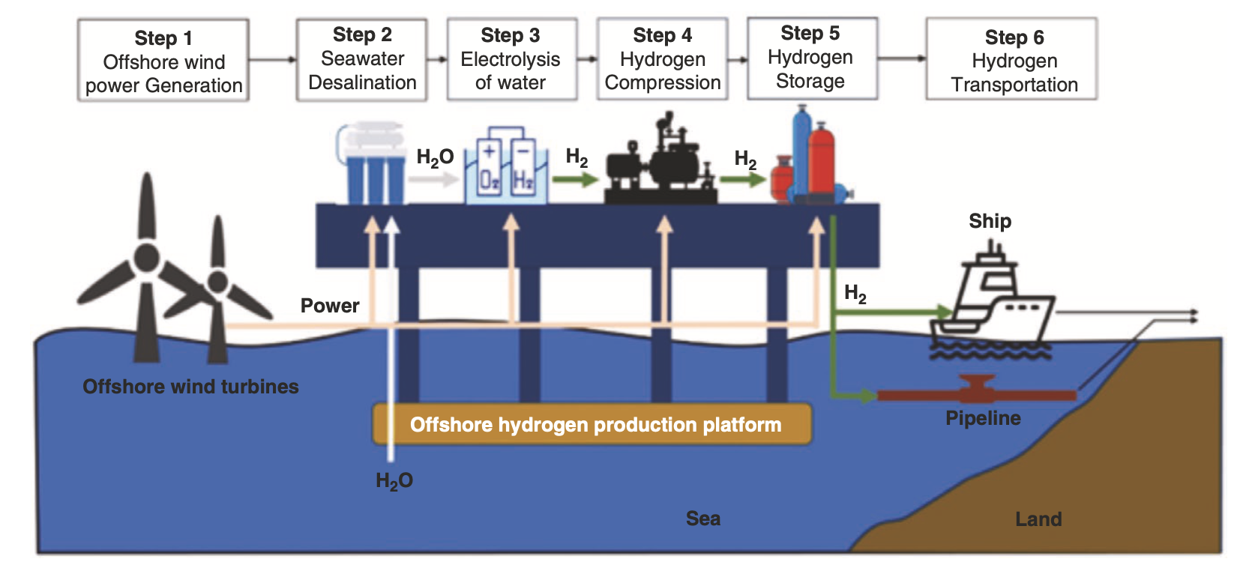
Course: Research Dissertation (ENGM083)
Working Principle
Flow Chart of the whole working principle:
Offshore
Wind Power Generation
Seawater Desalination
Electrolysis of water
Hydrogen Compression
Hydrogen Storage
Hydrogen Transportation
Figure 2: Working Principle of Offshore Green Hydrogen Production via Wind Powered Electrolysis.
6

Slide 7
Course: Research Dissertation (ENGM083)
Methodology
Research approach and workflow:
1
Literature Review
2
Selection of electrolyser
3
System Design & Boundary
4
Aspen HYSYS Simulation carried out mass and energy balance calculations
5
Techno Economic Analysis
6
Results and Discussion, Conclusions
Syed Yousaf Munib | 6933767 | sm04531@surrey.ac.uk
7

Slide 8
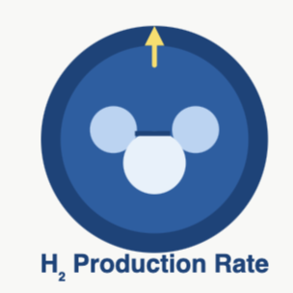

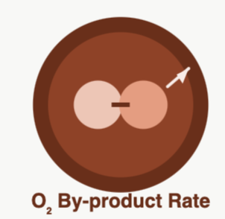
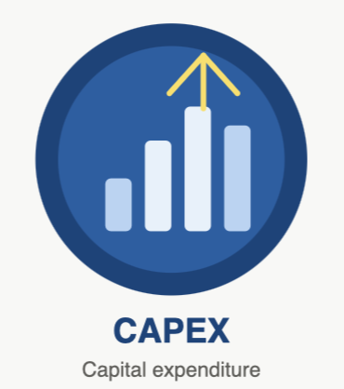




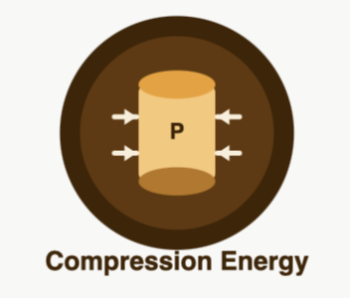
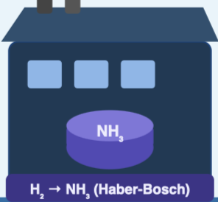
Course: Research Dissertation (ENGM083)
Results Analysis Framework
Mass & Energy Balance and Techno Economic Analysis:
Mass and Energy Balance
Techno Economic Analysis
Sensitivity Analysis
Wind variability.
Electricity cost.
Electrolyser performance.
Storage pressure (350 bar).
H₂ production rate.
Simulation:
Aspen HYSYS stoichiometric reactor model.
Reaction: 2H₂O → 2H₂ + O₂ .
8

Slide 9
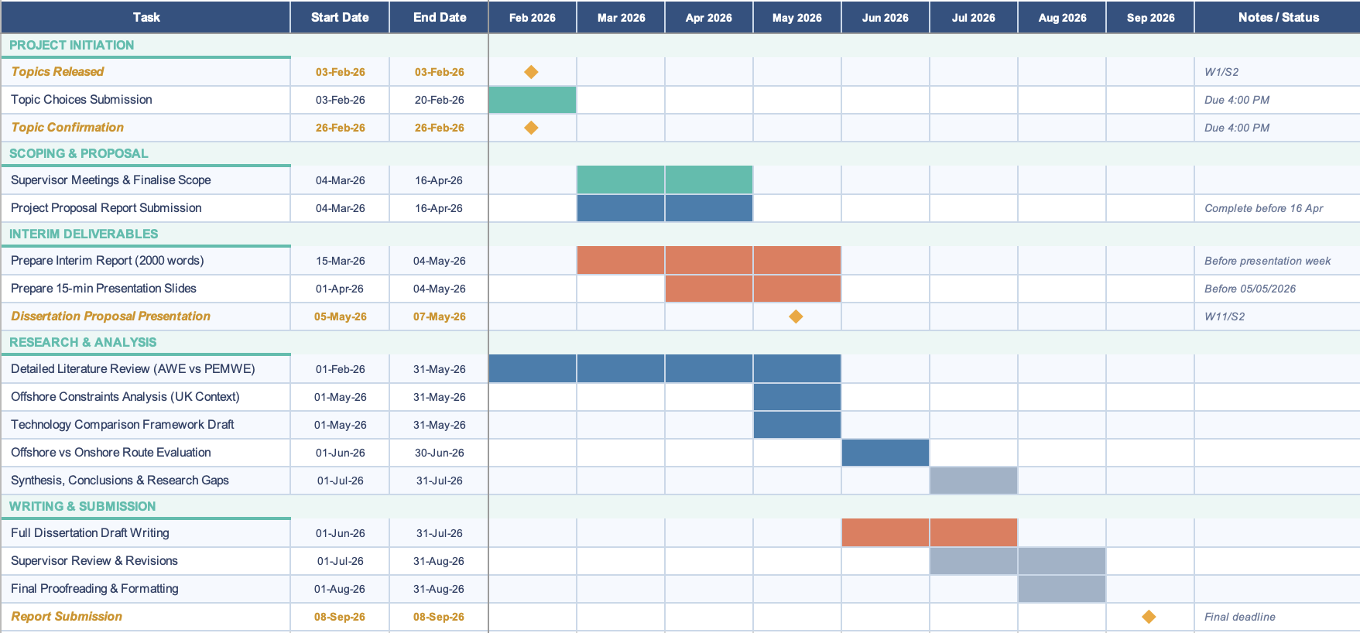
Course: Research Dissertation (ENGM083)
Project Timeline & Deliverables
9

Slide 10
Course: Research Dissertation (ENGM083)
References:
Aminaho, E.N., Aminaho, N.S. and Aminaho, F. (2025) ‘Techno-economic assessments of electrolysers for hydrogen production’ [Online]. Available at: https://www.sciencedirect.com/science/article/pii/S0306261925012450 (Accessed: 25 March 2026).
Carmo, M., Fritz, D.L., Mergel, J. and Stolten, D. (2013) ‘A comprehensive review on PEM water electrolysis’, International Journal of Hydrogen Energy [Online]. Available at: https://doi.org/10.1016/j.ijhydene.2013.01.151 (Accessed: 26 March 2026).
Ibrahim, O.S. et al. (2022) Dedicated large-scale floating offshore wind to hydrogen: Techno-economic and environmental assessment. Renewable and Sustainable Energy Reviews. Available at: https://www.sciencedirect.com/science/article/pii/S1364032122002258 (Accessed: 18 March 2026).
Niblett, D., Chiong, M.-C. and Zhang, Z. (2024) ‘Review of next generation hydrogen production from offshore wind using water electrolysis’ [Online]. Available at: https://www.sciencedirect.com/science/article/pii/S0378775323012806 (Accessed: 18 March 2026).
Ramakrishnan, S., Kolios, A., Cui, L. and Floros, M. (2024) ‘Offshore green hydrogen production from wind energy: Critical review and perspective’ [Online]. Available at: https://www.sciencedirect.com/science/article/pii/S1364032124000431 (Accessed: 01 April 2026).
Syed Yousaf Munib | 6933767 | sm04531@surrey.ac.uk
10

Slide 11
Course: Research Dissertation (ENGM083)
Travaglini, R. et al. (2025) Offshore or onshore hydrogen production? A critical comparison of wind-to-hydrogen pathways. Applied Energy. Available at: https://www.sciencedirect.com (Accessed: 01 April 2026).
Wu, L., Xu, Y., Wang, Q., Zou, X., Pan, Z., Leung, M.K.H. and An, L. (2025) ‘Direct seawater electrolysis for green hydrogen production: electrode designs, cell configurations, and system integrations’ [Online]. Available at: https://pubs.rsc.org/en/content/articlelanding/2025/ee/d5ee01093d (Accessed: 18 March 2026).
Rezaei, M. et al. (2024) Techno-economics of offshore wind-based dynamic hydrogen production. Applied Energy. Available at: https://www.sciencedirect.com/science/article/pii/S0306261924014132 (Accessed: 25 April 2026).
Syed Yousaf Munib | 6933767 | sm04531@surrey.ac.uk
11

Slide 12
Course: Research Dissertation (ENGM083)
Thank you !
Syed Yousaf Munib | 6933767 | sm04531@surrey.ac.uk
12

